Slide 1

OPTICAL FIBRE COMMUNICATIONS & MEASUREMENTS
Notes:
1
1

Slide 2
HISTORY + DEVELOPMENT 1/2
1870 John Tyndall showed light will follow curved jets of water issuing from a container.
Later J.L.Baird & others worked on transmission of light in glass rods, Patents filed.
1950s Brian O’Brian - American Optical Company + Narinder S. Kapany, Imperial College, worked on image transmitting fibres for medical applications etc.

Slide 3
HISTORY + DEVELOPMENT 2/2
1960 Theodore Maiman of Hughes Labs demonstrated first ruby laser
1962 Lasing in s/c chip first observed
1966 Kao & Hockham STL proposed transmission of information via transparent dielectric medium would require reduction of losses from 1000 to 20dB/km
1970 Corning achieve 20dB/km
Similar advances in sources, detectors, connectors and other related areas.

Slide 4
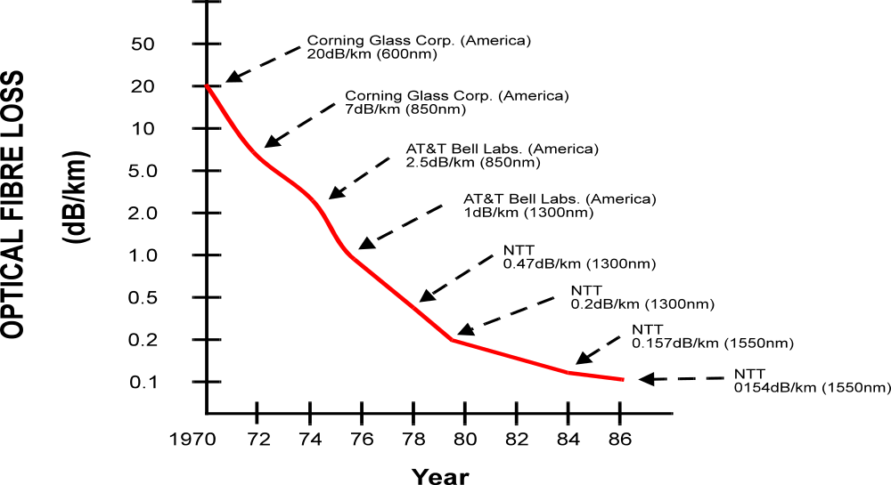
HISTORY OF LOSS REDUCTION

Slide 5
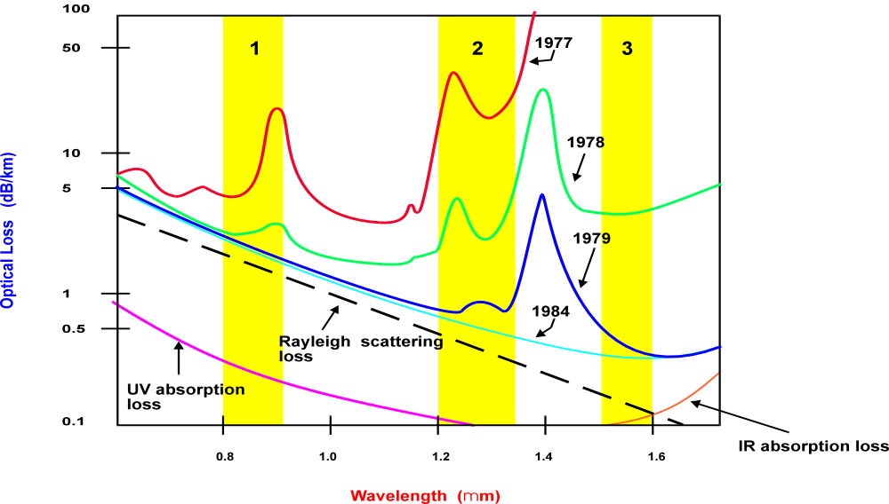
SPECTRAL LOSS REDUCTION
Used Windows:
1) 850nm MM
2) 1310nm MM
1310nm SM
3) 1550nm SM
4) 1625nm SM
4

Slide 6
WHY OPTICAL FIBRE?
Low Loss
High Bandwidth
EMI Immunity
Lightweight/small size
Negligible Cross-Talk
Safe in Explosive Environments
Difficult to Tap
No Scrap Value

Slide 7
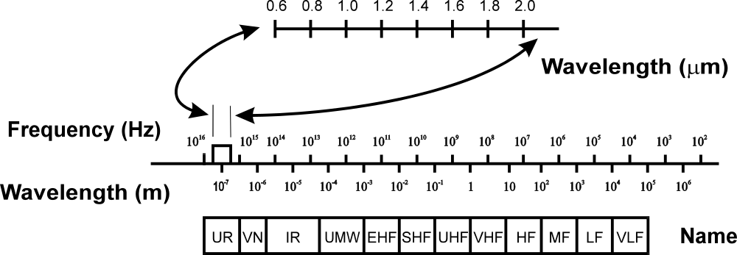
EM SPECTRUM
Includes visible red for POF !

Slide 8
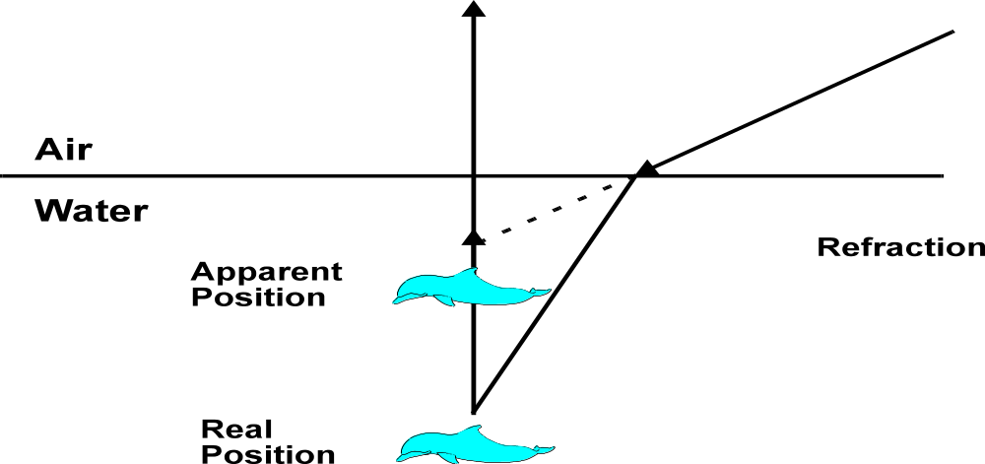
LIGHT RAYS & GEOMETRICAL OPTICS
Reflection & Refraction (1/3)

Slide 9
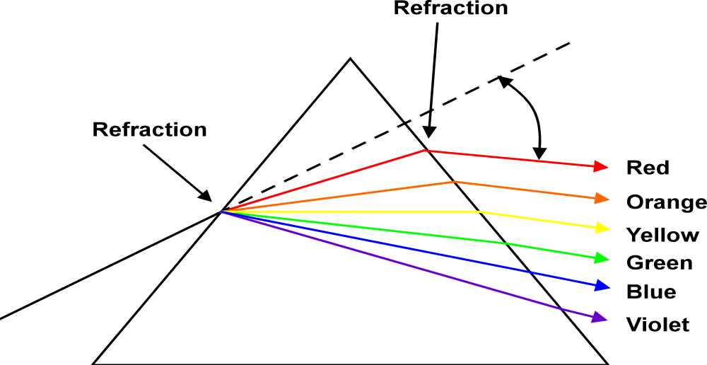
REFLECTION & REFRACTION (2/3)

Slide 10
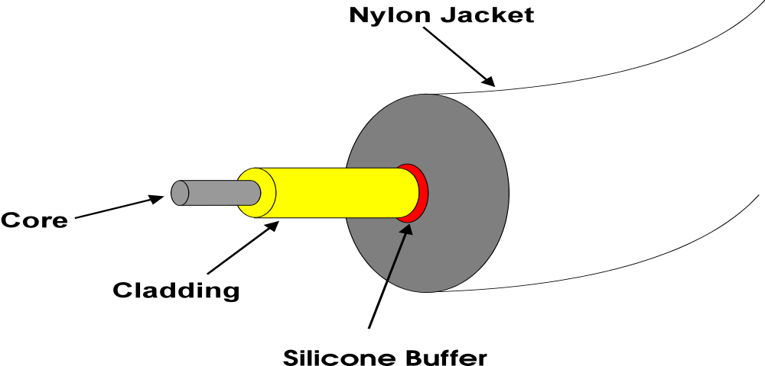
OPICAL CABLE CONSTRUCTION

Slide 11
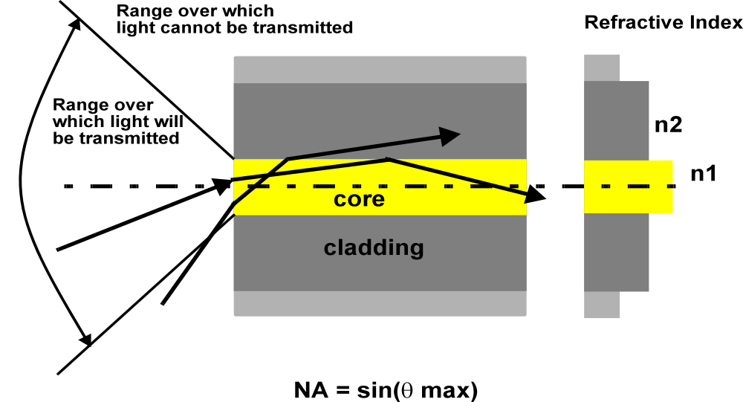
NUMERICAL APERTURE

Slide 12
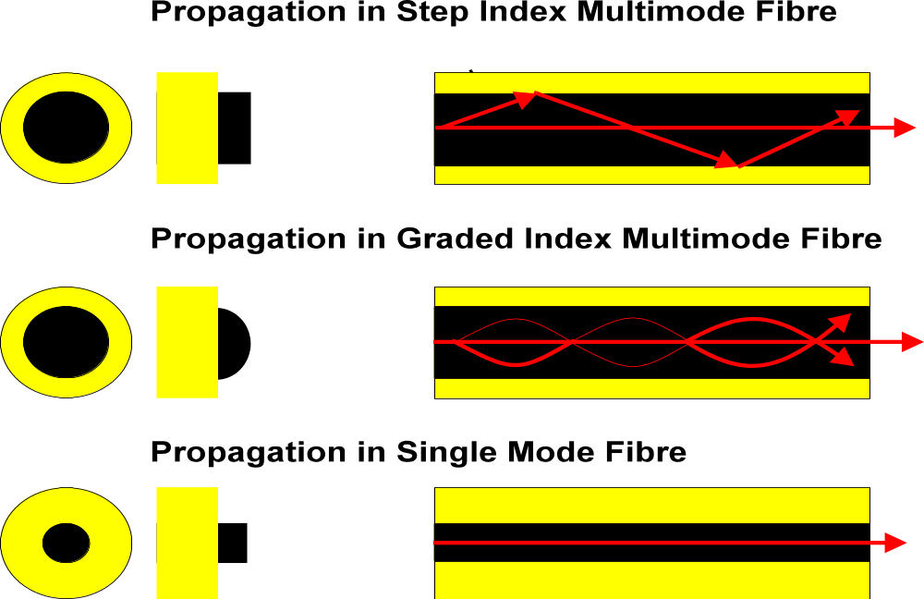
TRANSMISSION IN VARIOUS FIBRES

Slide 13
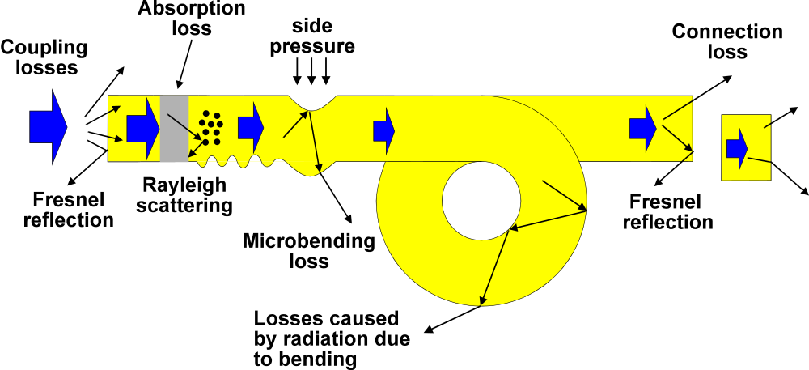
CAUSES OF LOSS

Slide 14
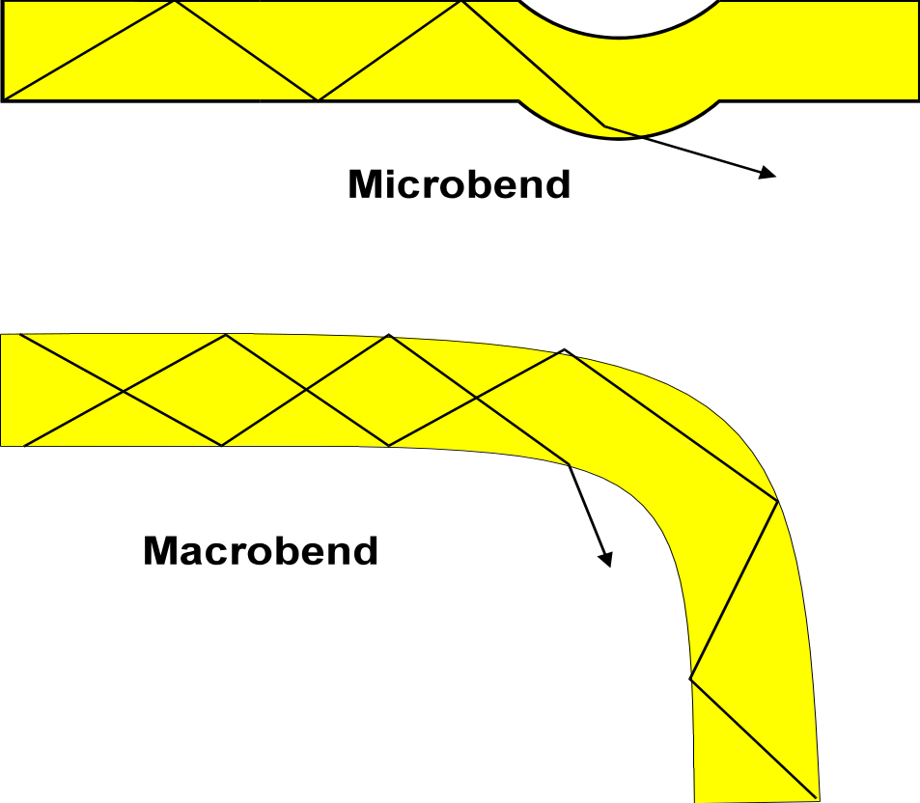
BENDS MICRO & MACRO

Slide 15
EQUILIBRIUM MODE DISTRIBUTION (MULTIMODE FIBRES)
Not all modes carry equal energy
Not all modes carry energy efficiently
Energy can transfer between modes
Launch condition
  underfilled
  overfilled
Mode scramblers/filters

Slide 16
CONNECTORS, SPLICES, SPLITTERS & COUPLERS

Slide 17
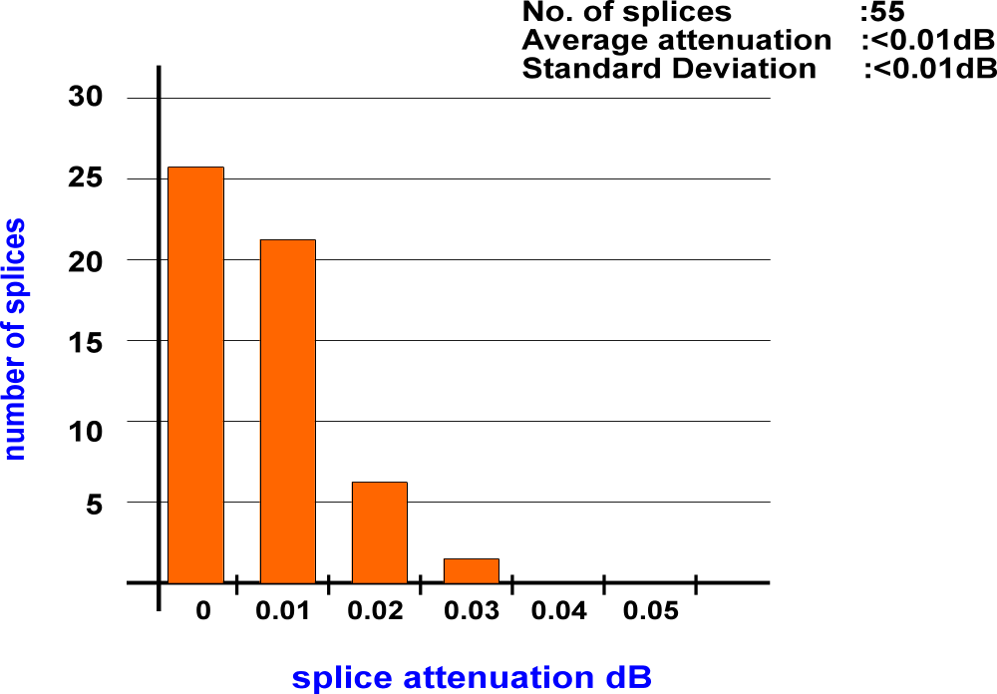
SPLICE LOSS DISTRIBUTION
Automatic Fusion Splicer, Identical Fibres

Slide 18
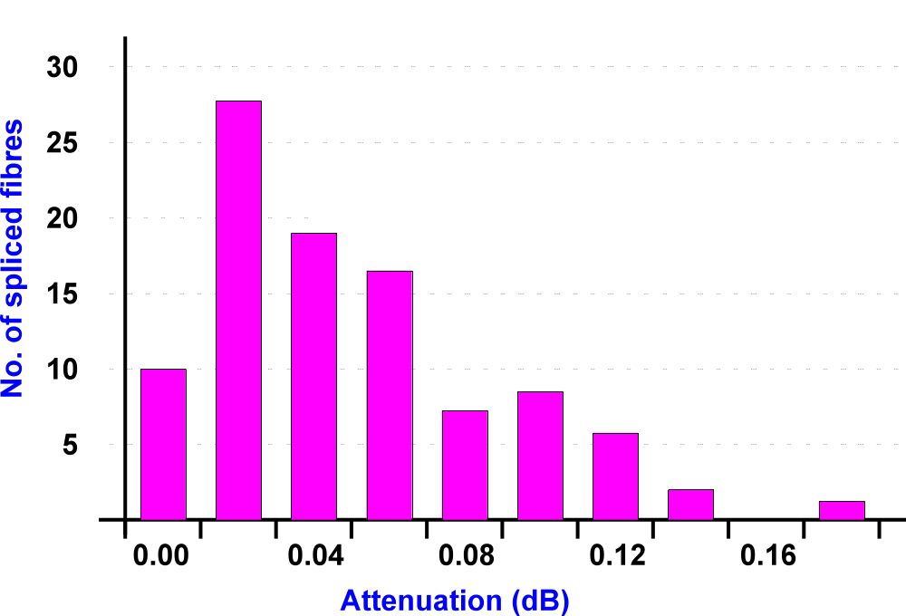
RIBBON SPLICERS
Splice Loss of 12 Fibre Ribbon
Fibre : SM
No of splices : 100
Ave splice loss : 0.06 dB
Std dev : 0.04 dB

Slide 19
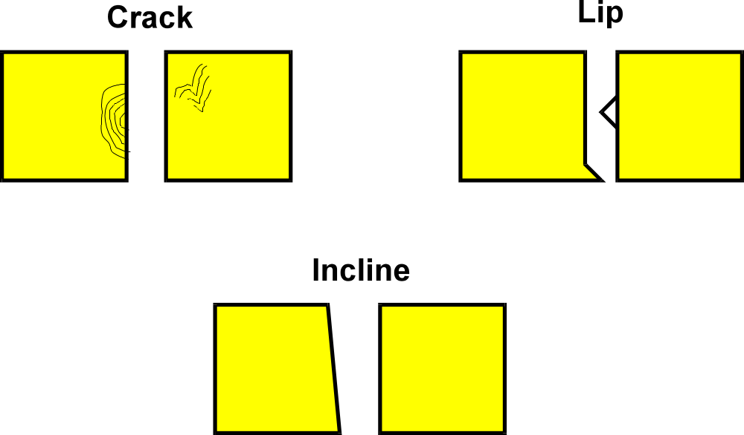
BAD CLEAVE EXAMPLES

Slide 20
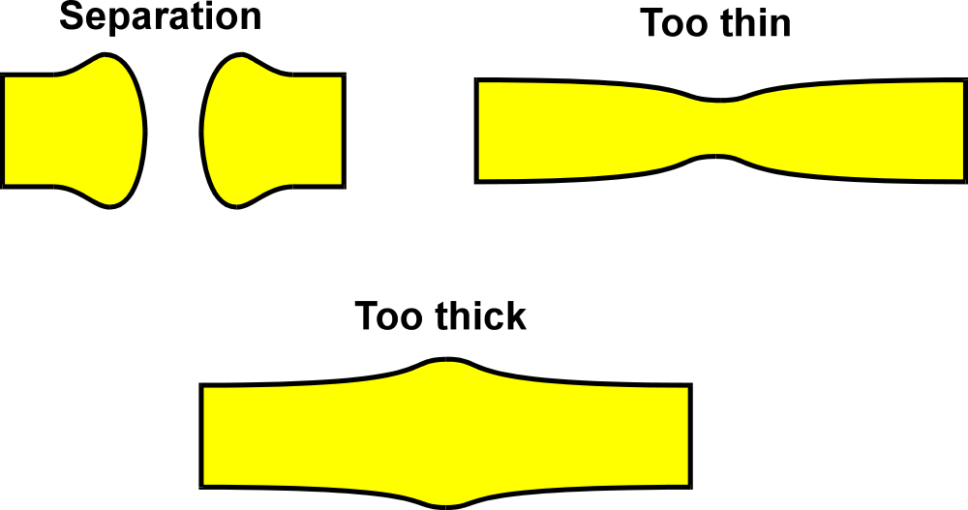
BAD SPLICE EXAMPLES

Slide 21
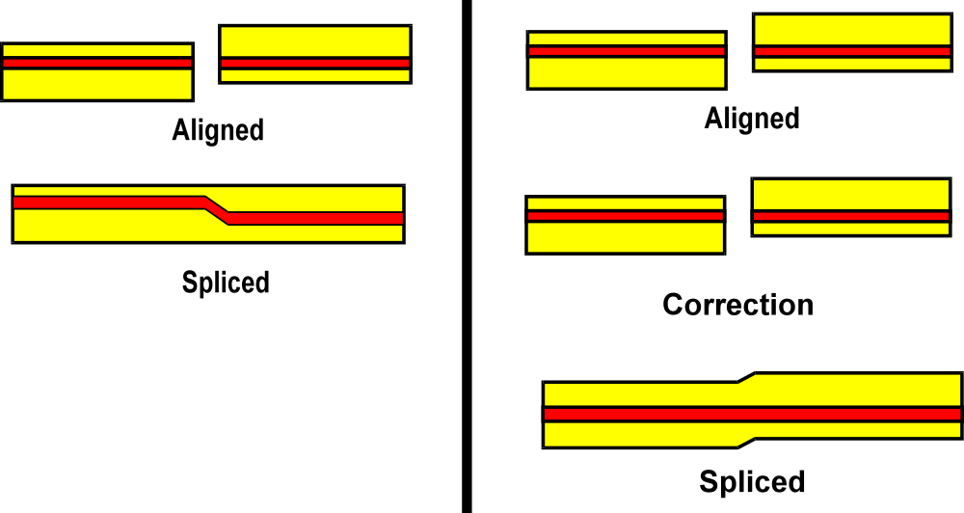
SURFACE TENSION EFFECT

Slide 22
CONNECTOR REQUIREMENTS
Low loss
  <0.2dB for T’comms / Long Haul
  ~0.3-1dB for LANs etc.
  1-3dB for v. short / v. cost dominated installations
Easy Installation
  Quick to fit, easy to learn how
Repeatability
Consistency
Economical

Slide 23
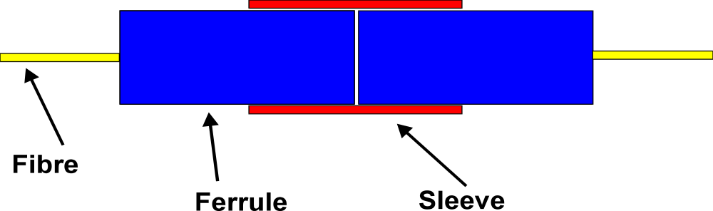
BASIC CONNECTOR

Slide 24
CAUSES OF LOSS AT A JOINT
Fibre Mismatch
  Core Diameter
  Cladding Diameter
  NA
  Concentricity
  Ellipticity
  Mode Field Diameter (Spot Size) (Singlemode)
Non-Perfect Cleave/Fibre End Surface
Fibre End Separation (Air Gap)
Lateral Displacement
Angular Misalignment
Mode Distribution (Multimode)

Slide 25
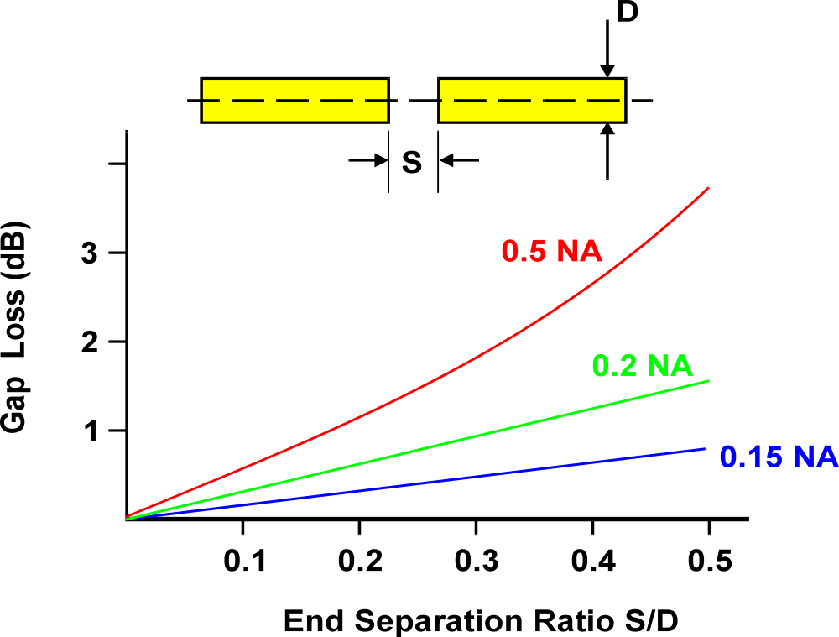
SEPARATION

Slide 26
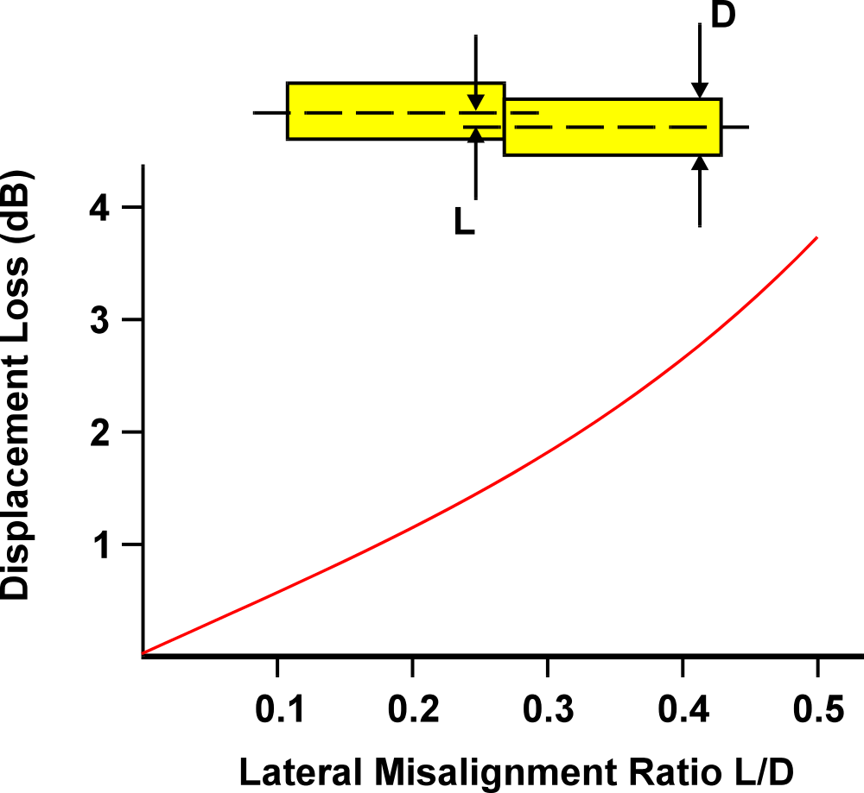
LATERAL

Slide 27
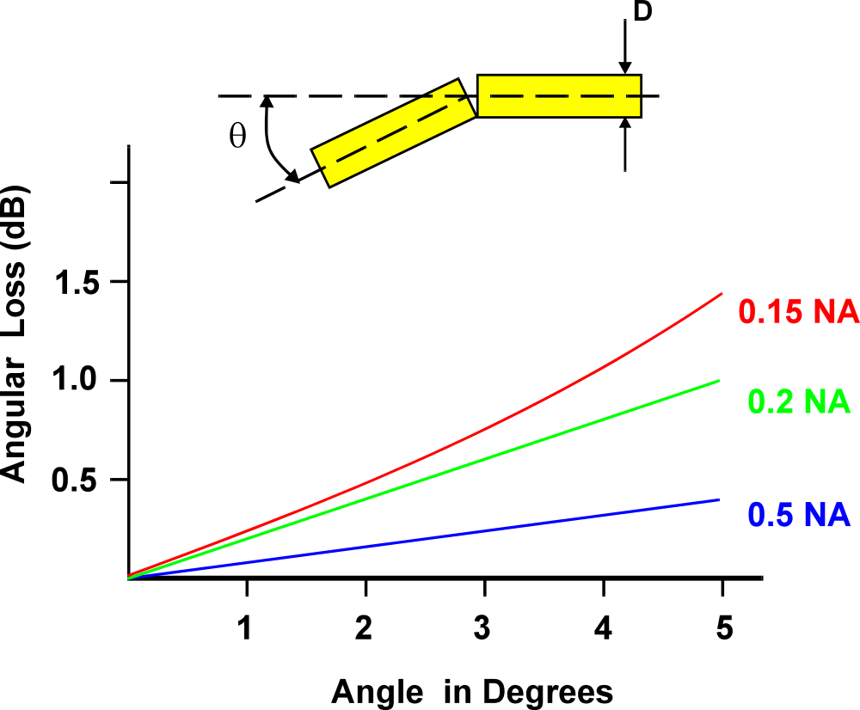
ANGULAR

Slide 28
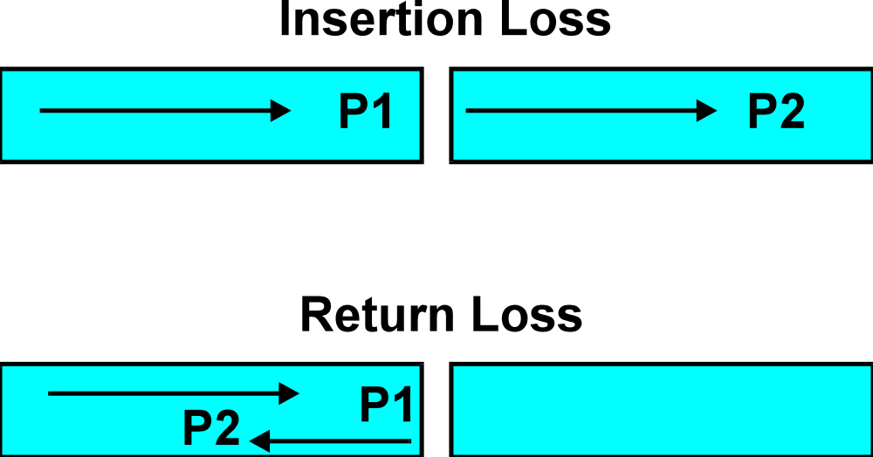
RETURN LOSS / INSERTION LOSS
P1-P2 (dB)
P1-P2 (dB)

Slide 29
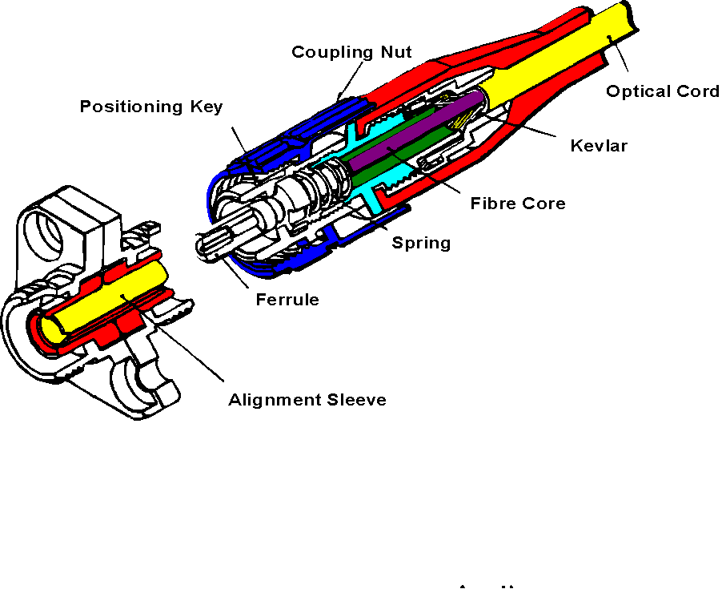
FC CONNECTOR
Seiko Instruments

Slide 30
OTHER CONNECTORS
Diamond E2000 LC
SC MU
DIN MTRJ
D4 Angular Versions (8°)
ST
MT/MPO
SMA
  905, 906
FDDI

Slide 31
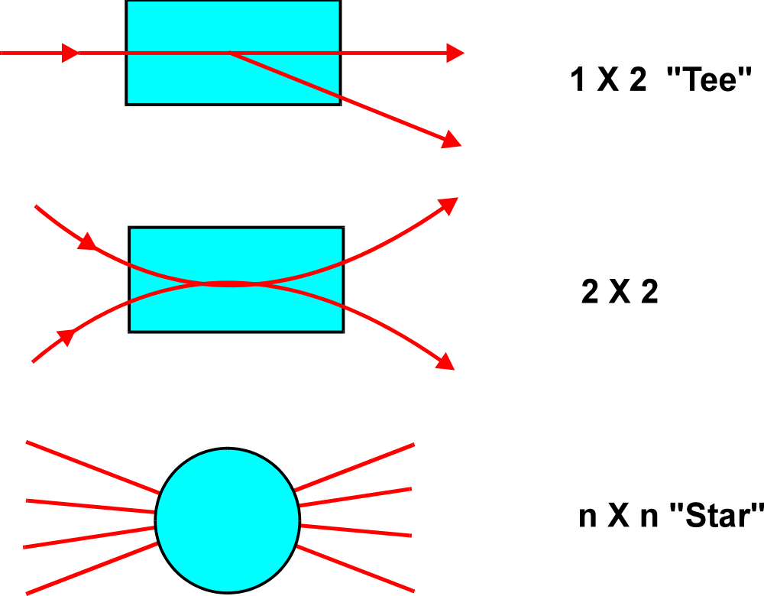
SPLITTERS & COUPLERS
Combine and Split the Light Paths, enabling Point to Multi-Point Transmission

Slide 32
WAVELENGTH DIVISION MULTIPLEXING & DEMULTIPLEXING
Different wavelengths in the same fibre do not interfere, so if they can be separated at the receiver end, capacity can be increased
Separation achieved by:
  Diffraction Gratings
  Interference Filters
  External Mirrors (CSR technology)

Slide 33
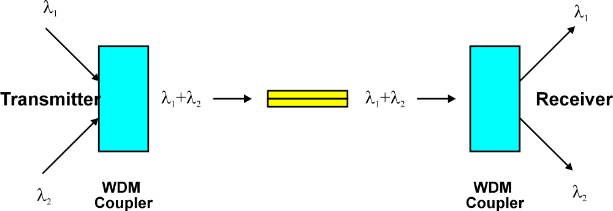
WDM
Coarse WDM : 1310/1550/1625nm
Dense WDM : Grid standarized by ITU, Channel spacing 100GHz and 50GHz
50GHz spacing Δλ∼0,4nm at 1550nm

Slide 34
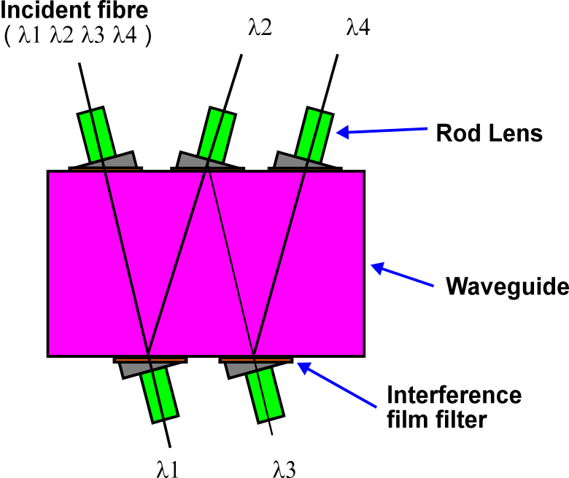
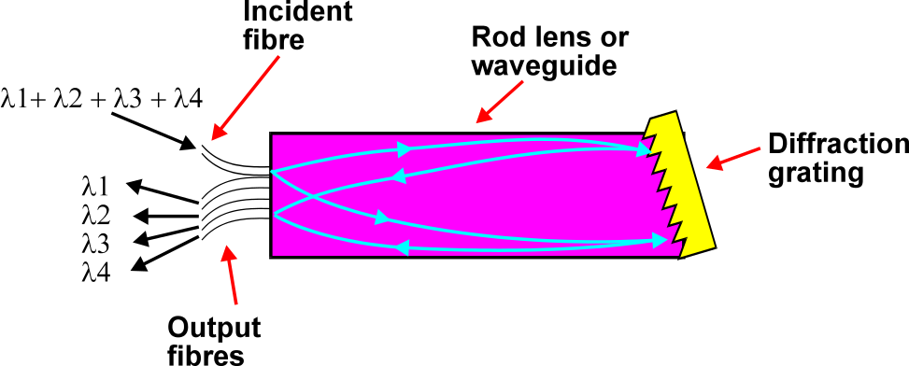
DEMULTIPLEXER EXAMPLES

Slide 35
OPTICAL FIBRE COMMUNICATIONS & MEASUREMENTS SEMINAR
Part 2: Introduction to Measurements

Slide 36
OPTICAL POWER
Relative
  (%), usually dB
  Requires good linearity
Absolute
  mW, μW, dBm (Relative to 1mW)
  Requires good accuracy & traceability

Slide 37
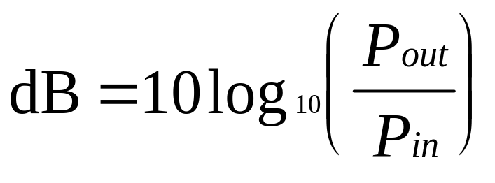


THE OPTICAL dB
Relative unit
DUT
-3dB = 50% power lost
-10dB = 90% loss, ie. is 10% of
-20dB = 99% loss, ie. is 1% of
-30dB = 99.9% loss, ie. is 0.1% of

Slide 38
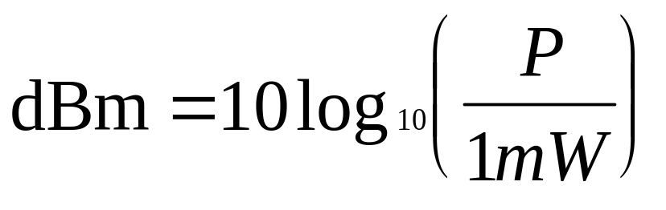

The dBm
Absolute power - expressed relative to 1mW
DUT
+10dBm = 10mW
0dBm = 1mW
-3dBm = 500μW
-10dBm = 100μW
-13dBm = 50μW
-20dBm = 10μW
-30dBm = 1μW
-60dBm = 1nW

Slide 39
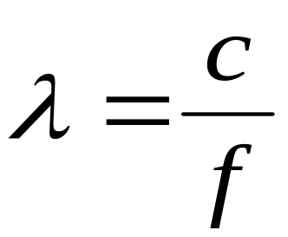
WAVELENGTH
Absolute
  Centre/RMS Wavelength
    System Source Wavelength
    Test Equipment Wavelength
Relative
  Spectral Widths (FWHM)
    System Source
    Test Equipment

Slide 40
STANDARDS
Optical Power (Absolute)
  NPL, National Standards
  Transfer Optical Power Meter to NAMAS Accredited Calibration Site
  NAMAS Lab calibrates users’ Working Standards/Field Power Meters
Wavelength
  Gas Discharge Tubes, Physical Constants
    Ar, Kr, Ne, Hg, He-Ne
    Emit Spectral Lines across a Range of Wavelengths

Slide 41
OTDR FUNCTIONS
Distance / Length Measurement
  km, m, ft
Fibre Loss Measurement
  dB, dB/km
Connector / Splice Loss Measurement
  dB Loss
  Return Loss

Slide 42
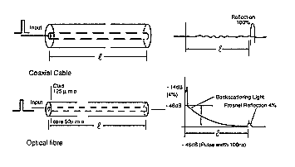
TDR (Copper) vs OTDR (Fibre)

Slide 43
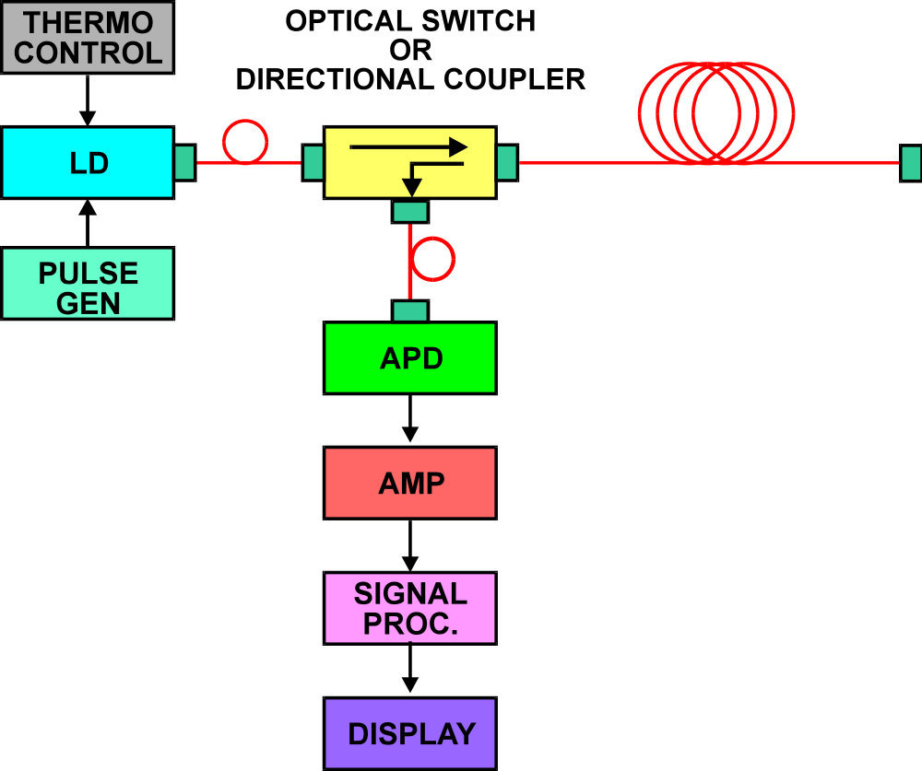
OTDR BLOCK DIAGRAM

Slide 44
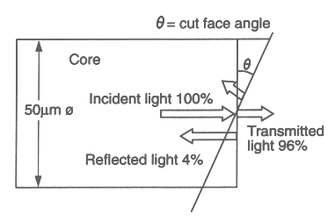
FRESNEL REFLECTION
Perfectly cleaved fibre / air interface gives 4% (-14dB) reflection (Fresnel Reflection)
If end angle > 5.5º, virtually no Fresnel Reflection occurs at all

Slide 45
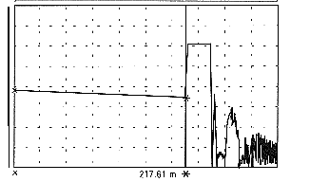
BREAK LOCATION

Slide 46
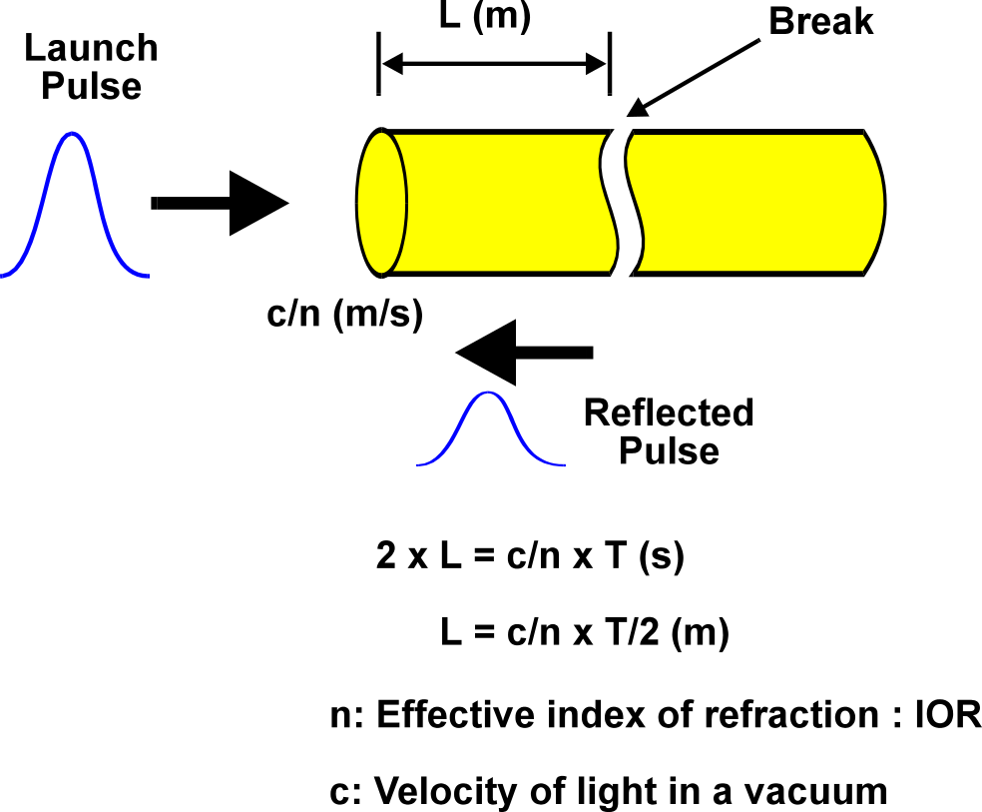
DISTANCE MEASUREMENT BY OTDR

Slide 47
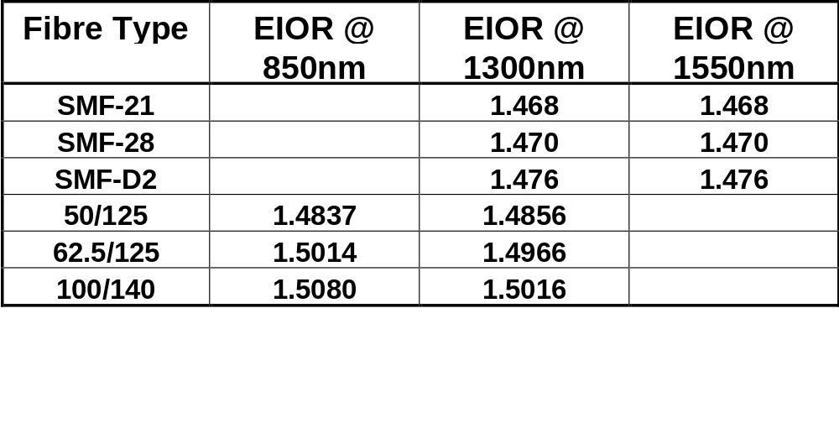
EFFECTIVE REFRACTIVE INDEX

Slide 48
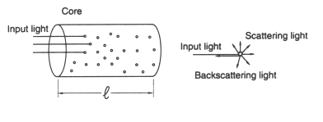
BACKSCATTER

Slide 49
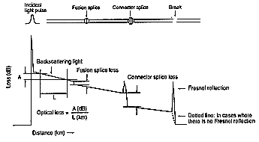
TYPICAL OTDR TRACE

Slide 50
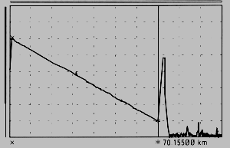
FIBRE LOSS
2PA = Two Point Approximation
LSA = Least Squares Approximation

Slide 51
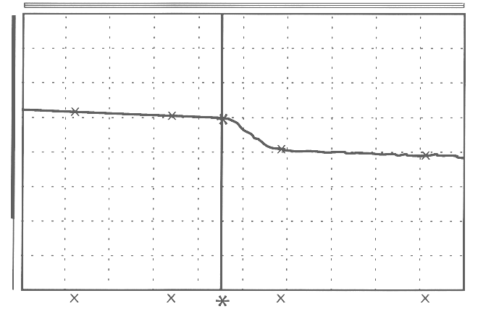
SPLICE LOSS
2PA = Two Point Approximation
LSA = Least Squares Approximation

Slide 52
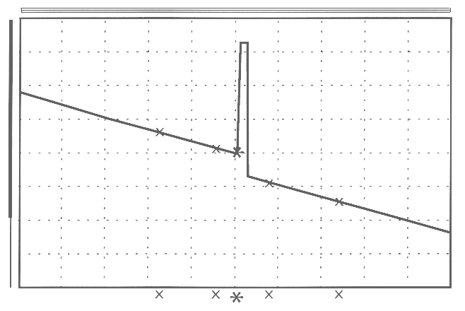
CONNECTOR LOSS

Slide 53
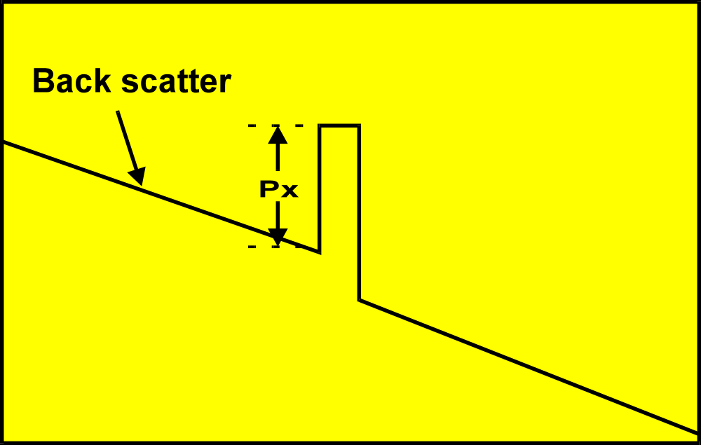
RETURN LOSS

Slide 54
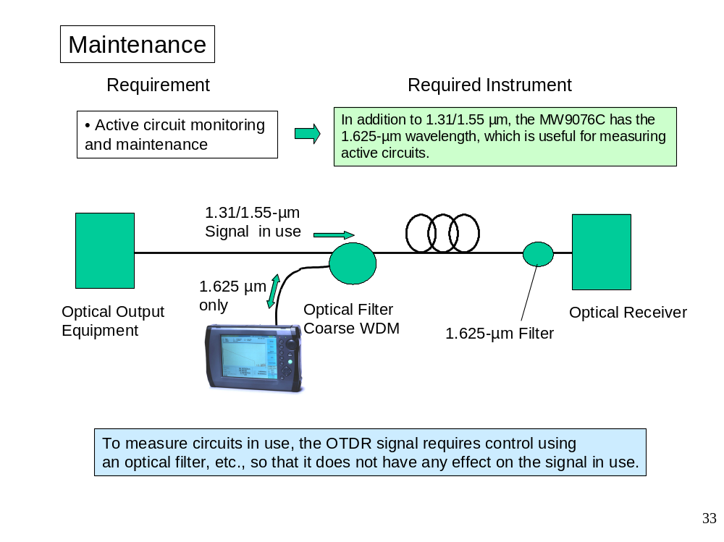
A=(FWC-13/15-16-N-2-1)
C=(BFC-13/15-16-N-2-1)
B=(BFC-16-13/15-N-2-1)

Slide 55

OTDR TERMINOLOGY(1/4 )
Fresnel Reflection
Rayleigh Backscatter
Plug-ins, Fibre Type
Laser Wavelength
Dynamic Range Definitions
Distance Range ( Measurement Range)
Pulse Widths
Resolution
  Read out, Horizontal + Vertical
  Spatial, Reflective
  Spatial, Non-Reflective

Slide 56
OTDR TERMINOLOGY(2/4)
LSA/2PA; What difference does it make?
Accuracy / Linearity
Calibration
IOR/EIOR
Dead Zone
Dead Zone Loss Extrapolation
Sampling Rate
Display Data / Measurement Data
Masks
  Variable Width, Near End Mask

Slide 57
OTDR TERMINOLOGY(3/4)
Ghosts
Noise and Averaging
Smoothing
Splice Gains and Two-Way Measurements
Receiver Saturation
Manual / Auto Attenuation
“Full Trace” Display
Laser Output Power Variation
Launch Level

Slide 58
OTDR TERMINOLOGY(4/4)
Trace Comparison
Event Tables, Splice Thresholds and Auto Search
Procedure / “Macro” Functions
Macro/Micro Bends
Data Storage Media
Emulation Software

Slide 59
RETURN LOSS
Typical Figures (Approx.)
  Perfect (90º)Cleave ,Glass/Air Interface..-14dB
  SMA Connector (Mated pair).................-12dB
  ST Connector ( " )...........-12~-35dB
  (-65dB, Angled, SM)
  FC Connector ( " )....................-14dB
  PC Connector ( " )..............-25~-35dB
  SPC Connector ( " )..............-40~-45dB
  UPC Connector ( " )..............-50~-55dB
  APC Connector ( " ).....................-65dB
Higher value figure = Lower reflectance loss = Better connector

Slide 60
IMPORTANCE OF RETURN LOSS
-Effects of Excess Reflection (1/2)
Transmitter
  Laser Mode Hopping
  Laser Output Power Fluctuations
  Increase in Laser Linewidth (Spectral Width)
  Degraded Freqency Response
Receiver
  Multiple Path Interference (MPI)
    Multiple reflections add to the original signal , effectively increasing the noise

Slide 61
IMPORTANCE OF RETURN LOSS
-Effects of Excess Reflection (2/2)
System
  Erratic System Performance
  Increased BER in High Speed Digital Signals
  Degraded SNR in High Bandwidth Analogue Systems
  Distortion in Analogue Systems caused by Non-Linearity

Slide 62
IMPORTANCE OF RETURN LOSS
-Effects Depend Upon:
Magnitude of Individual Reflections
Source Wavelength
Source Coherence Length
Distance between Reflections
  If separation > source coherence length then the return loss will be constant

Slide 63
BANDWIDTH-LENGTH PRODUCT
Multimode Fibres
'Figure of Merit' eg. 600MHz.km
  NOT per km
  BW x Length =< 600
  ie. 600MHz signal can be transmitted for 1km
  Lower freqency can go further,or
  Higher frequency over shorter distance

Slide 64
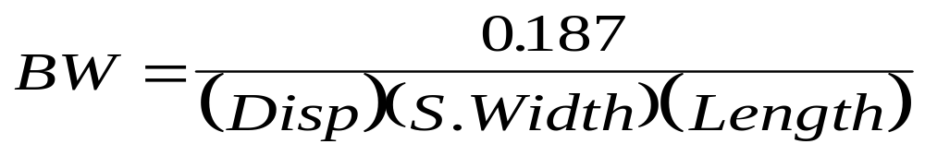
CHROMATIC DISPERSION
Unit = ps/nm/km or ps/nm.km (equivalent)
ie. propagation time difference for each nm of source spectral width per fibre km
Approximate Bandwidth is given by
with Dispersion in seconds/nm/km,
Spec Width in nm, Length in km

Slide 65
CHROMATIC DISPERSION Measurement (1/4)
Methods
  Fibre Raman Laser + Spectroscope , Measure Delay and Differentiate
  Multiple LEDS, Baseband Phase Comparison
  Multiple LDs, Baseband Phase Comparison
  Interference Method

Slide 66
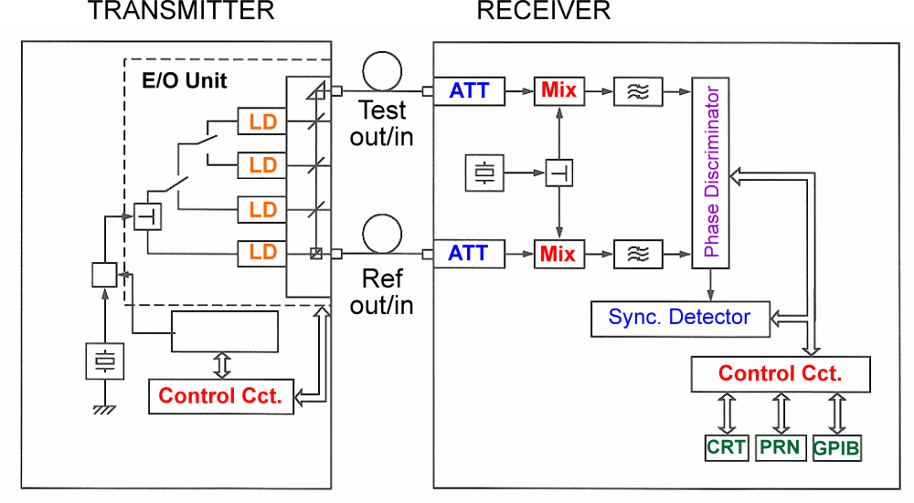
CHROMATIC DISPERSION Measurement (2/4)

Slide 67
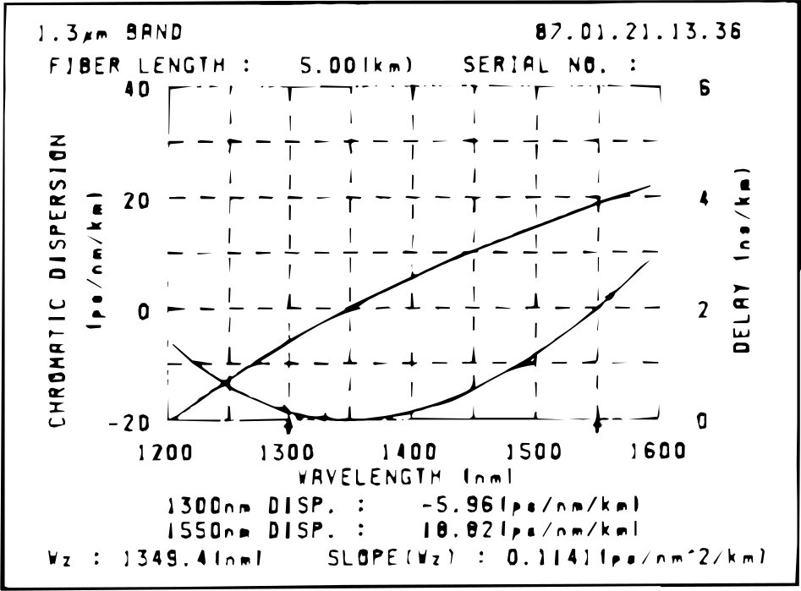
CHROMATIC DISPERSION Measurement (4/4)

Slide 68
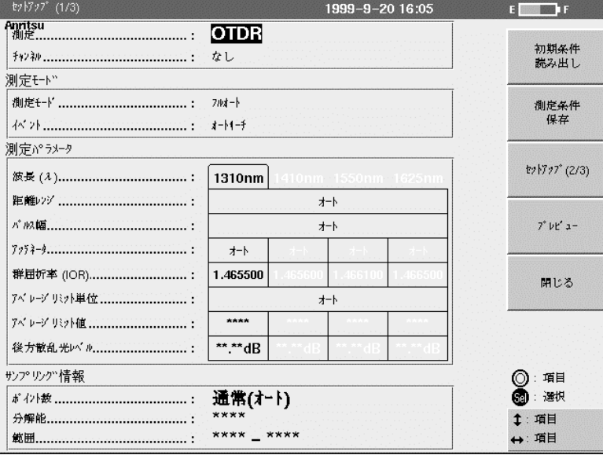
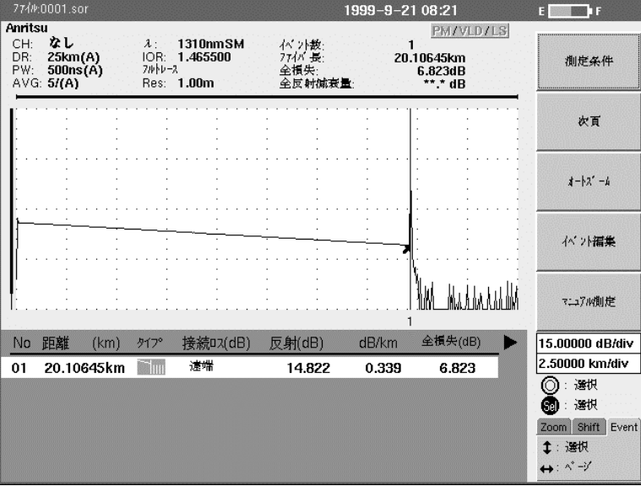
CD measurement procedure
1. Measurement in OTDR mode（Full Auto）
to find the fiber length (I.e. DR)
Set-up screen
Measurement screen

Slide 69
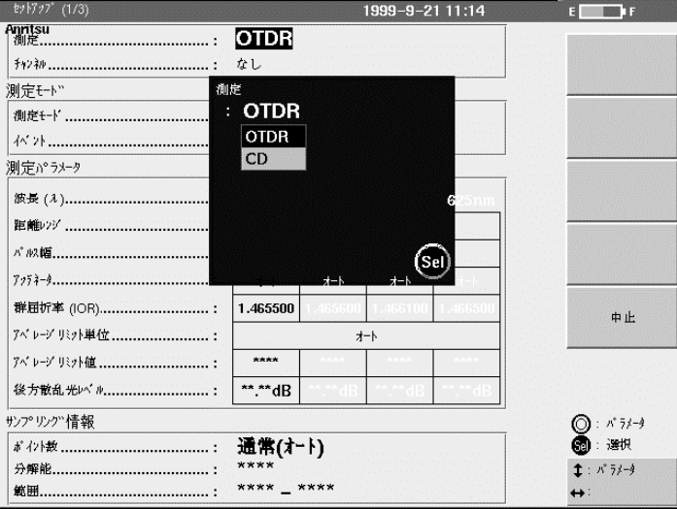
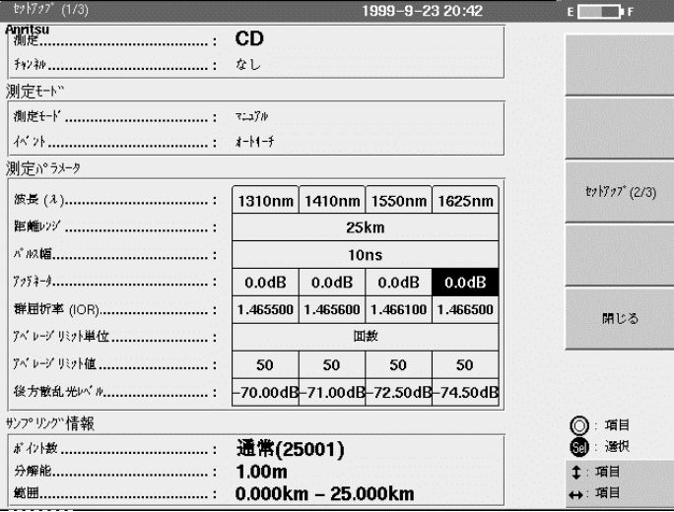
2. Measurement in CD mode
Change the mode to CD, and set the DR to the appropriate value and PW to 10ns, ATT to 0dB.
Then press Start key. Or use full Auto Mode (Firmw.3.1)
Change the mode to CD
Set-up screen

Slide 70
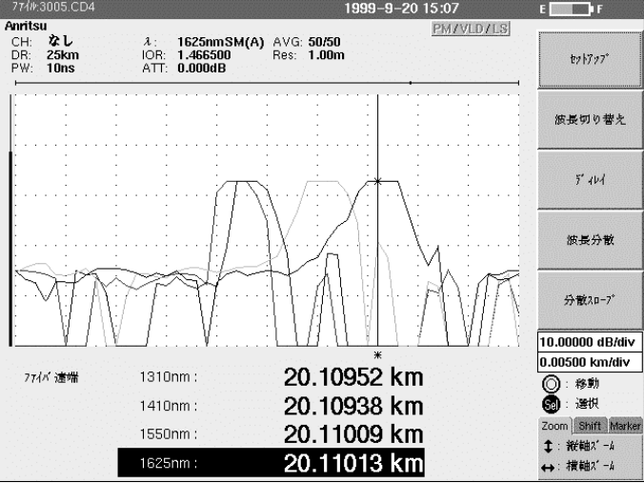
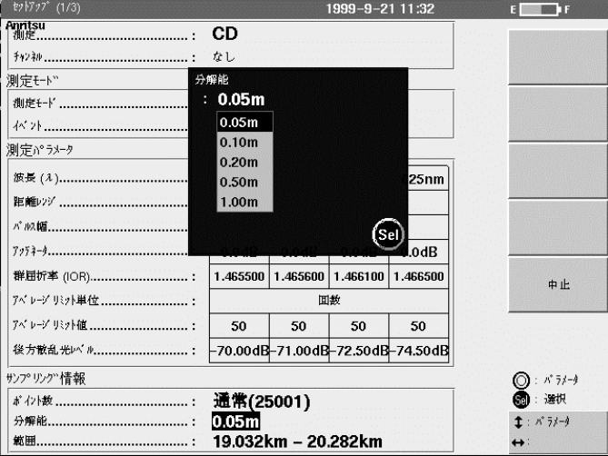
Note: In full Auto Mode all is done automatically !!!
3. H-Zoom arround
the end reflection
4. Return to set-up screen
And set the resolution to
0.05m then press start key
H-zoom
Setting to 0.05m

Slide 71



5. ATT setting
Wrong example（saturation）
ATT setting
Good example

Slide 72


6. Marker setting at each reflections
OTDR wave
Set the marker at
The weighted center

Slide 73

7. analysis
Select approximation formula
Aλ²⁺bλ+c・・・DSF
A+bλ²+cλ^{－2}・・SMF

Slide 74



